Slide 1
Section 1.7 Logarithms

Slide 2
Basic Logarithms
Definition of a Logarithm:
$$b^{x}=a⇔\log_{b}{a}=x$$
$$e^{x}=a⇔\ln{a}=x$$

Slide 3
Example 1
Write $3^{5}=243$ as a logarithmic equation
Write ${10}^{4}=10,000$ as a logarithmic equation

Slide 4
Solution to Example 1
Write $3^{5}=243$ as a logarithmic equation:
Answer: $\log_{3}{243=5}$
B) Write ${10}^{4}=10,000$ as a logarithmic equation:
Answer: $\log{10,000=4}$

Slide 5
Example 2
Write $4^{3}=64$ as a logarithmic equation
Write ${10}^{2}=100$ as a logarithmic equation
Write $e^{0}=1$ as a logarithmic equation

Slide 6
Solution to Example 2
Write $4^{3}=64$ as a logarithmic equation:
Answer: $\log_{4}{64=3}$
B) Write ${10}^{2}=100$ as a logarithmic equation:
Answer: $\log{100=2}$
C) Write $e^{0}=1$ as a logarithmic equation:
Answer: $\ln{1=0}$

Slide 7
Example 3
Write each logarithmic equation as an exponential equation.
$\log_{5}{125}=3$
$\log\left(100,000\right)=5$

Slide 8

Solution to Example 3
$\log_{5}{125}=3⇒5^{3}=125$
$\log\left(100,000\right)=5⇒{10}^{5}=100,000$

Slide 9
Example 4
Use a calculator to evaluate the following logarithms. Round to the nearest hundredth.
$\log{(200)}$
$\log\left(34\right)$
$\ln{(34)}$
$ln⁡(e)$

Slide 10
Solution to Example 4
Use a calculator to evaluate the following logarithms.
$\log{(200)}=2.30$
$\log\left(34\right)=1.53$
$\ln{(34)}=3.53$
$\ln\left(e\right)=1$

Slide 11

Example 5
Graph $y=\ln{(x)}$

Slide 12
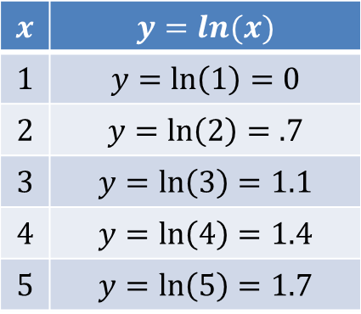
Solution to Example 5
Set up a chart of values and plot the points.
$$x$$ | $$y=ln(x)$$
$$1$$ | $$y=\ln\left(1\right)=0$$
$$2$$ | $$y=\ln\left(2\right)=.7$$
$$3$$ | $$y=\ln\left(3\right)=1.1$$
$$4$$ | $$y=\ln\left(4\right)=1.4$$
$$5$$ | $$y=\ln\left(5\right)=1.7$$

Slide 13
Example 6
Graph $y=5\log{(x+1)}$

Slide 14
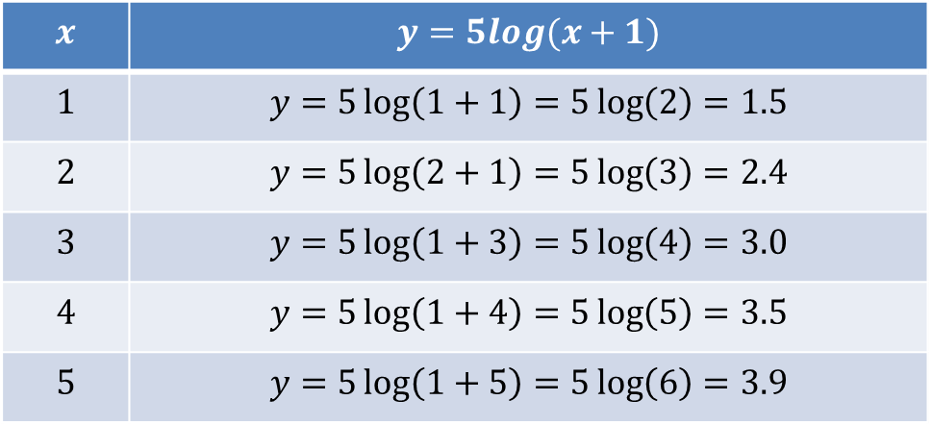
Solution to Example 6
Set up a chart of values and plot the points.
$$x$$ | $$y=5log(x+1)$$
$$1$$ | $$y=5\log\left(1+1\right)=5\log\left(2\right)=1.5$$
$$2$$ | $$y=5\log\left(2+1\right)=5\log\left(3\right)=2.4$$
$$3$$ | $$y=5\log\left(1+3\right)=5\log\left(4\right)=3.0$$
$$4$$ | $$y=5\log\left(1+4\right)=5\log\left(5\right)=3.5$$
$$5$$ | $$y=5\log\left(1+5\right)=5\log\left(6\right)=3.9$$

Slide 15

Solution to Example 6
Graph of $y=5\log{(x+1)}$

Slide 16
Example 7
Graph $y=\ln{(x+2)}$

Slide 17
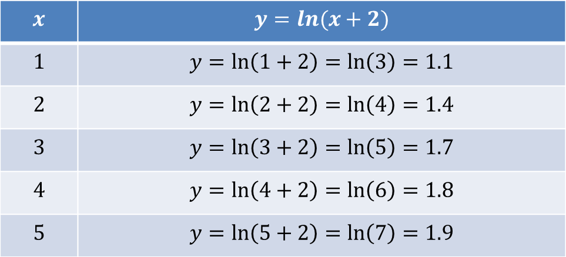
Solution to Example 7
Set up a chart of values and plot the points.
$$x$$ | $$y=ln(x+2)$$
$$1$$ | $$y=\ln\left(1+2\right)=\ln\left(3\right)=1.1$$
$$2$$ | $$y=\ln\left(2+2\right)=\ln\left(4\right)=1.4$$
$$3$$ | $$y=\ln\left(3+2\right)=\ln\left(5\right)=1.7$$
$$4$$ | $$y=\ln\left(4+2\right)=\ln\left(6\right)=1.8$$
$$5$$ | $$y=\ln\left(5+2\right)=\ln\left(7\right)=1.9$$

Slide 18
Solution to Example 7
Graph of $y=ln⁡(x+2)$

Slide 19
Example 8
A logarithmic model to approximate the percentage P of an adult height a male has reached at an age A from 11 and 18 is
$$P=12\log\left(A−10\right)+84$$
Use the model to predict the boy’s percentage of height at age 15.

Slide 20
Solution to Example 8
Use the age model the percentage of adult height.
$$P=12\log\left(A−10\right)+84$$
$$P=12log\left(15−10\right)+84$$
$$P=12\log\left(5\right)+84$$
$$P=8.4+84$$
$$P=92.4\%$$

Slide 21
Example 9
Use the model in example 8 to predict the boy’s percentage of height at age 13.
$$P=12\log\left(A−10\right)+84$$

Slide 22
Solution to Example 9
Use the model to find the percentage of the boy’s height:
$$P=12\log\left(A−10\right)+84$$
$$P=12\log\left(13−10\right)+84$$
$$P=12\log\left(3\right)+84≈89.7 \%$$

